Slide 1
Interfaces for OSeMOSYS
  MoManI – Model Management Infrastructure
  LEAP – the Long-range Energy Alternatives Planning system
  Run an input file directly on the command line, e.g, using Notepad++ to write input file and a compatible solver

Slide 2
Interfaces for OSeMOSYS
  MoManI – Model Management Infrastructure
  LEAP – the Long-range Energy Alternatives Planning system
  Run an input file directly on the command line, e.g, using Notepad++ to write input file and a compatible solver

Slide 3
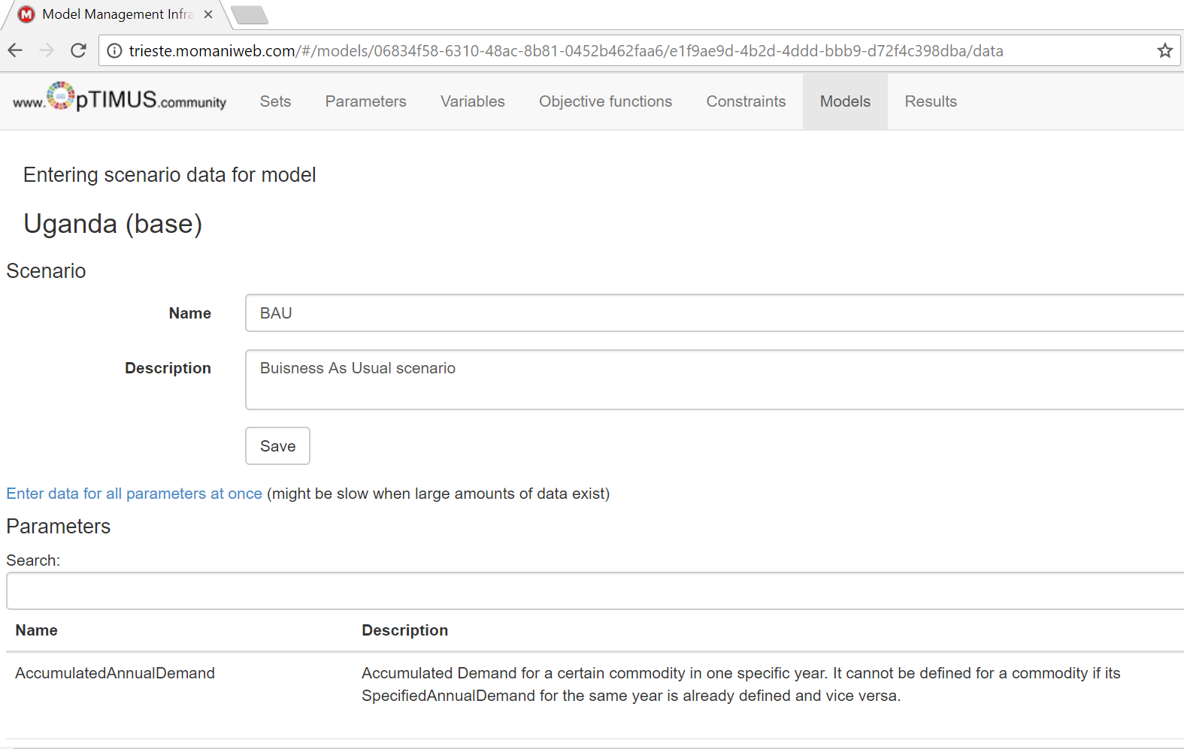
Interfaces for OSeMOSYS: MoManI
http://courses.momaniweb.com/#/models

